Slide 1
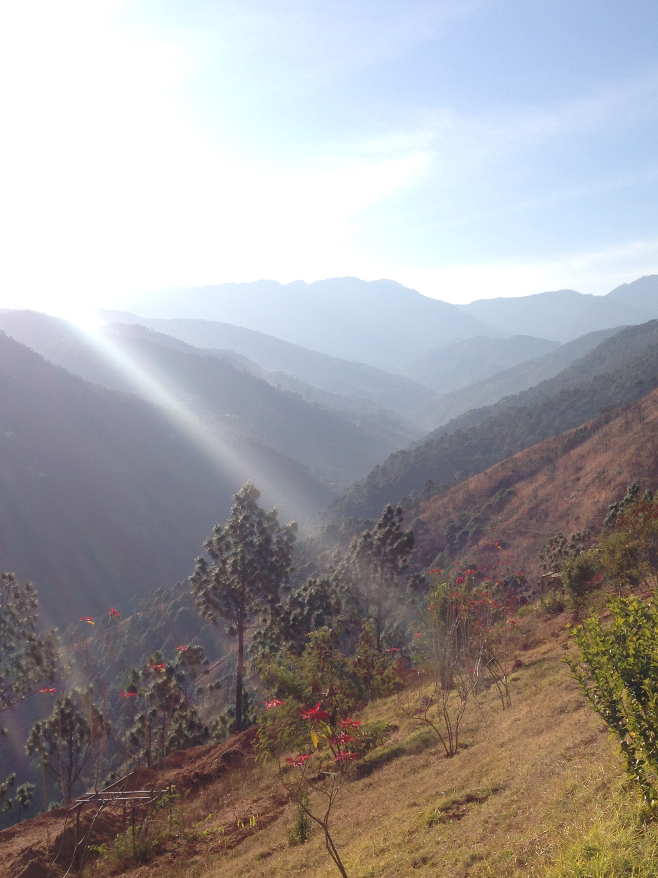
Introduction to MOUNTAINS!

Slide 2
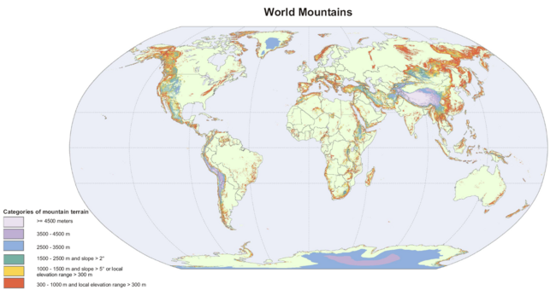
With a partner, identify and explain one observation about mountains you can find from this map.

Slide 3
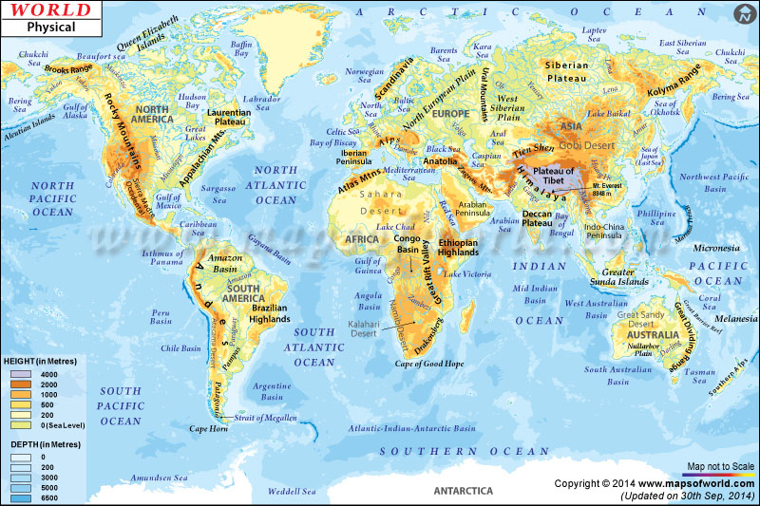
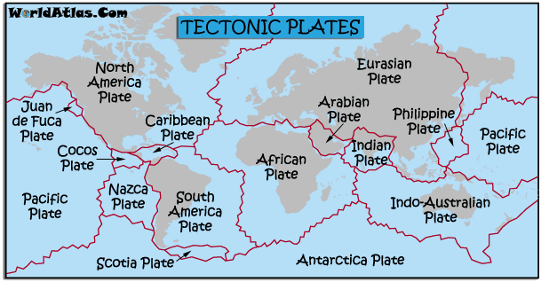
Thinking back to what we studied in regards to plate tectonics, WHERE are mountains located in the world?

Slide 4
The World’s Mountains and Ranges
Mountains make up about 1/4 of the world’s landscape
Some of the highest mountains are found under the sea EG: Mauna (Mount) Loa, Hawaii
Heights of mountains: measured “above sea level”
Altitude: height above sea level - how do humans experience this?
Groups of mountains together are called a mountain range
Name some examples of ranges.
Himalayas (Asia) - our case study; the Alps (Europe); the Andes (South America); the Rocky Mountains (North America)

Slide 5
The Himalayas…

Slide 6
Hypothesise: What do humans use mountains for?

Slide 7
What goes up, must come down…

Slide 8
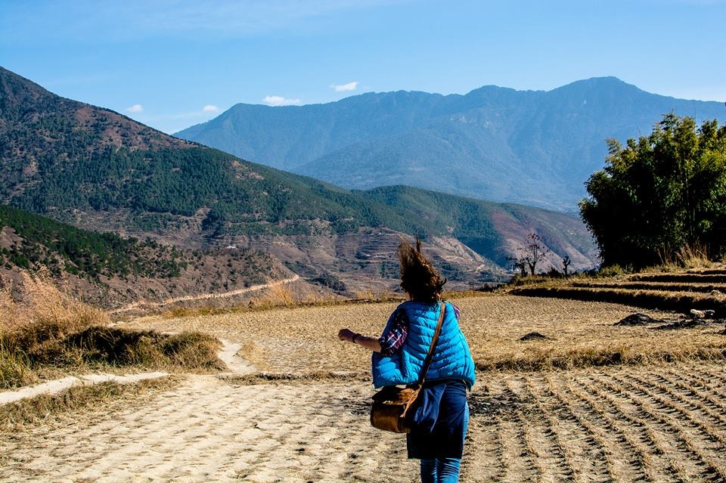
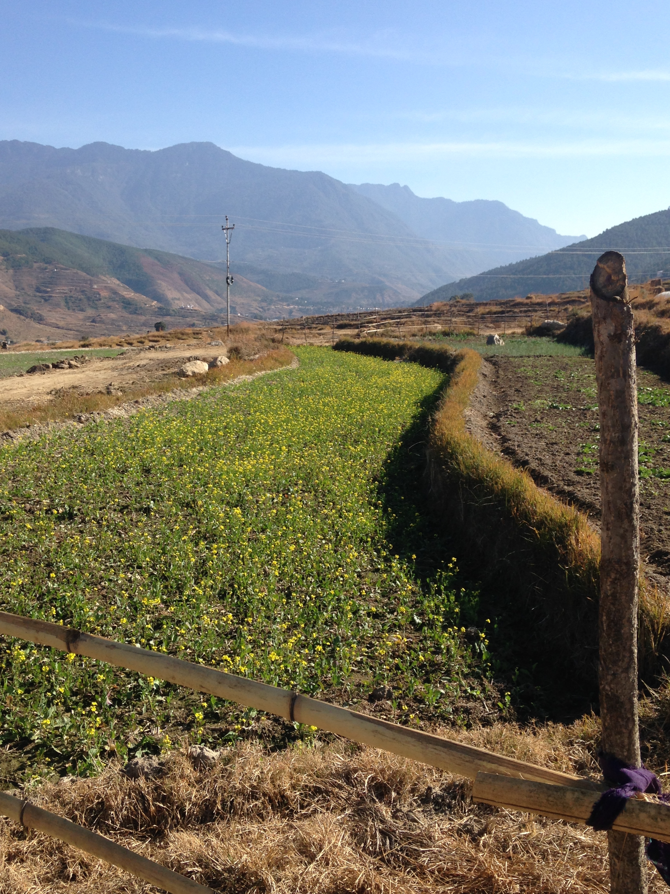

Slide 9
Human Uses of Mountains
Few people live in highest mountain ranges - why?
Recreation - examples?
Critical for global water supply - 60-80% - warm air rises, and cools as it passes high ground - water vapour becomes liquid and falls as rain (or snow) - image…
Rugged and difficult to cross - provided a safe place for indigenous people and ethnic minorities EG: slaves in St Kitts and Nevis - image…
Uses of valleys in between mountains?
Sacred and special places EG: Dreamtime (page 73)

Slide 10
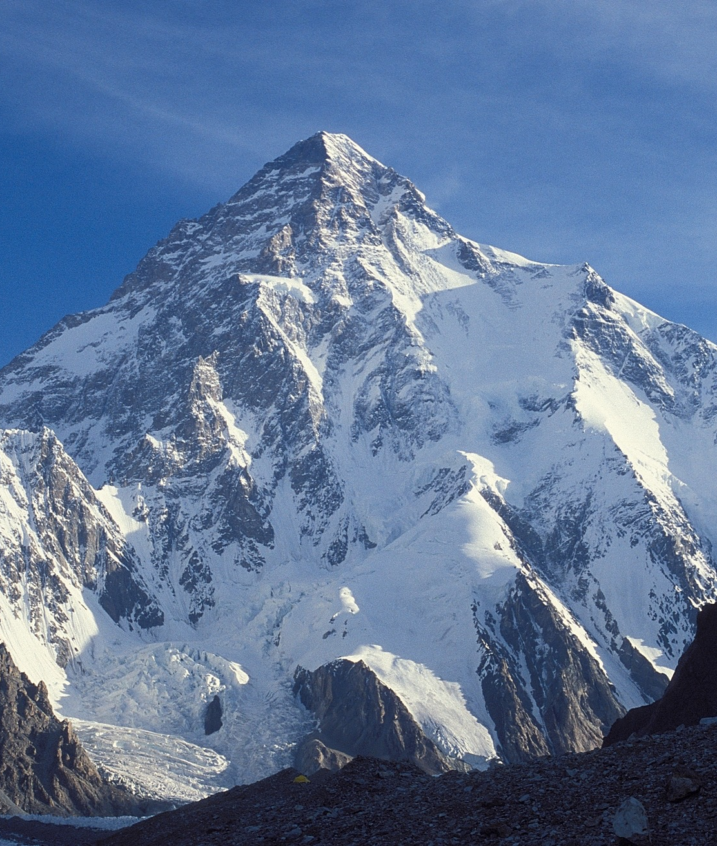
Study Figure 2, page 71
Using only the image (not the text), make a claim about a general theme you see in the image.
Using the accompanying text, find evidence to support your claim.
How does vegetation change on a mountain?
Imagine you are a mountaineer, climbing from the bottom to the top of K2 (see image and continue to use Figure 2). What sorts of clothing would you need?
What human uses can you think of for K2?
What skills would you need to survive living on K2?

